Slide 2
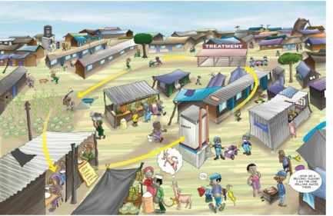
Water Sector Trust Fund
SOCIAL MARKETING
Focus & Levels of Intervention:
From Awareness to Sales
people, place, product, price, participation, promotion, policy, programs, positioning, partnerships, poo, pee

Slide 3
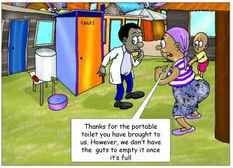
Focus of UBSUP’s Social Marketing:
The provision of safe sanitation facilities will only improve people’s health if toilets are well used & maintained and people have good personal hygiene
That is why UBSUP’s social marketing focuses on:
Triggering demand for improved sanitation & community participation
Encouraging proper use & maintenance of toilets through awareness creation & training
Increasing improved hand washing practices
Encouraging safe & proper disposal of human waste

Slide 4
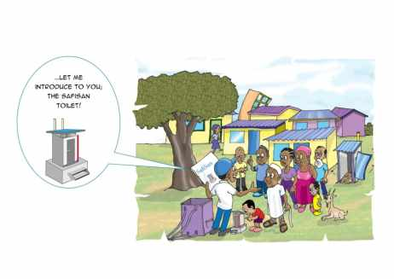

Social Marketing: Levels of Intervention
    National level
    Water Service Provider and town level
    Area (community) level
    Plot & household level

Slide 5
UBSUP social marketing: From macro to micro level
Level | National
Emphasis | Awareness creation
Messages | Importance of good sanitation (better toilets)
 | 2. The UBSUP programme & its objectives
 | 3. The SafiSan toilets & their advantages
 | 4. The sanitation value chain
 | 5. Importance of hand washing
Media | Mass media: | TV, radio
 | Print media: | Newspapers
 | Visibility materials: | Mascot, slogan, logo, song, animation
Activities | TV & radio (questions & answers) sessions (Q&A)
 | Newspaper advertisement

Slide 6
UBSUP social marketing: From macro to micro level
Level | Water Service Provider and/or town level
Empahsis | Awareness creation > sensitisation > marketing
Messages | Importance of good sanitation (better toilets)
 | 2. The UBSUP programme & its objectives
 | 3a. The SafiSan toilets & their advantages
 | 3b. How to get a safiSan toilet
 | 4. The sanitation value chain (decentralised treatment)
 | 5. Importance of hand washing
Media | Mass media: | Local TV & radio, SMS messaging
 | Print media: | Banners, posters, brochures, flyers
 | Visibility materials: | Mascot, slogan, logo, t-shirts, caps
Activities | TV & radio Q&A sessions, SMS messages
 | Putting up billboards & banners
 | Video presentations

Slide 7
UBSUP social marketing: From macro to micro level
Level | Area level
Emphasis | Awareness creation, sensitisation & marketing
Messages | Importance of good sanitation (better toilets)
 | 2. The UBSUP programme & its objectives
 | 3a. The SafiSan toilets & their advantages
 | 3b. How to use and get a SafiSan toilet
 | 4. Sanitation value chain (decentralised treatment in the area)
 | 5. Importance of hand washing
Media | Community media: | Barazas, fairs P.A. Announcements, skits
 | Print media: | Banners, posters, brochures, flyers
 | Visibility materials: | Mascot, slogan, logo, t-shirts, caps
Activities | PA announcements, SafiSan baraza shows, drama performances
 | Putting up billboards & banners, opinion leaders’ presentations
 | Video presentations, visits to sewage treatment works

Slide 8
UBSUP social marketing: From macro to micro
Level | Plot and household level
Emphasis | Sensitisation & marketing
Messages | Importance of good sanitation (better toilets)
 | 2. The UBSUP programme & its objectives
 | 3a. The SafiSan toilets & their advantages
 | 3b. How to get and use a SafiSan toilet (detailed procedure)
 | 4. The sanitation value chain (decentralised treatment)
 | 5. Importance of hand washing
Media | Print media: | Hand book, brochures, flyers, manuals
 | Demonstration: | Demonstration toilets, video presentations
 | Visibility materials: | Mascot, slogan, logo, t-shirts, caps
Activities | Plot visits & meetings at plot level
 | Handing out brochures
 | Toilet demonstrations (using demo toilet or video)

Slide 9
UBSUP social marketing: From macro to micro level
Awareness creation Sensitisation Marketing Sale
Level | National | WSP | Town | Area & community | Plot & household
 | Macro | Macro | Macro | Meso | Micro
Objective | awareness creation | awareness creation | sensitisation & marketing | marketing & sale | marketing, sale, and proper use
KAP ⁽¹⁾ | Knowledge | Knowledge Attitude | Knowledge Attitude Practice | Knowledge Attitude Practice | Knowledge Attitude Practice
Media | TV & radio commercials adverts | radio (Q&A) banners | road shows, banners police band | posters drama barazas | plot visits posters, demos forms, contract

Slide 10
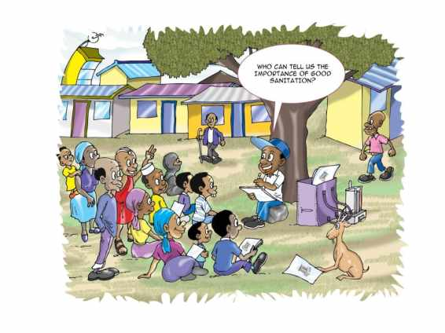
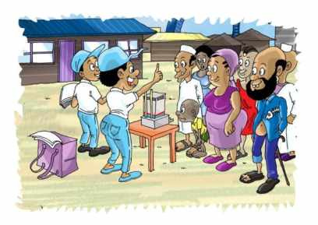
UBSUP Social marketing: From macro to micro level
    Plot & household level activities:

Slide 11
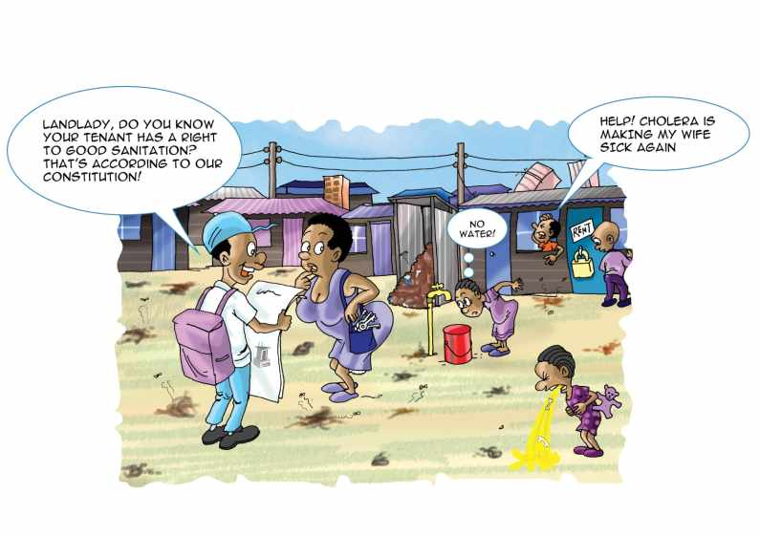
Thank You!

Slide 13


